Slide 1
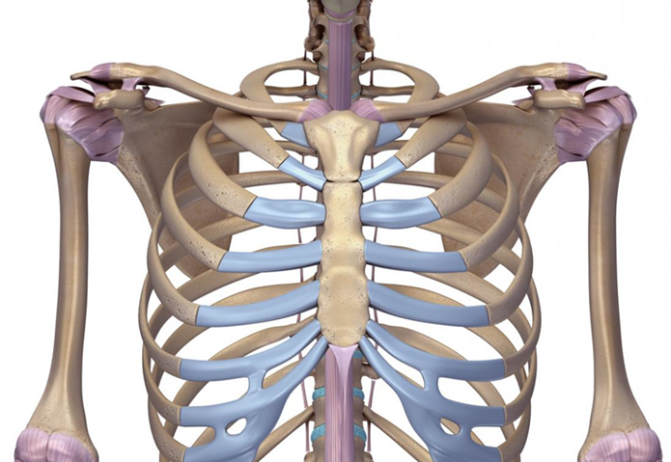
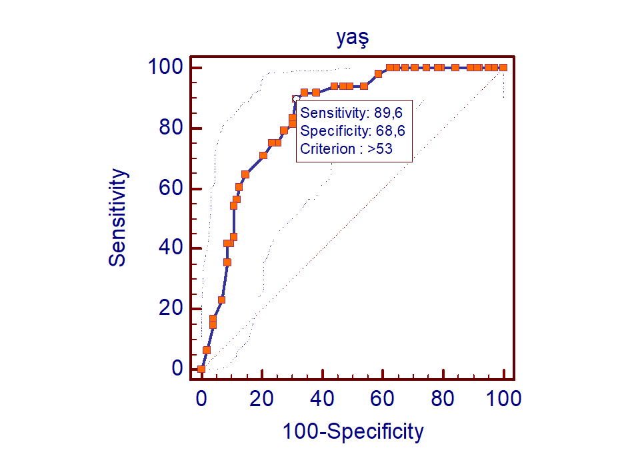
Age Determination by Evaluation of Costochondral Joint and Sternum on CT
Enes Parlayan¹, Temel Fatih Yılmaz²
¹Bezmialem Vakif University, School of Medicine, Istanbul, Turkey
²Bezmialem Vakif University, School of Medicine, Department of Radiology, Istanbul, Turkey
Introduction
Bone age (skeletal age) has an important place in both medical and forensic applications. It can be used in the diagnosis and treatment in the medical field and in the decision process in forensic cases. The most commonly used method for this is hand and wrist radiography. However, completed hand and wrist bone ossification makes age determination difficult especially in cases over the age of 18. Therefore, since this method can not be used in the adult age group, alternative methods are required. The aim of this study is to evaluate whether the fusion and calcification degrees between the sternum segments and costochondral joint calcifications have a value in the determination of age using thorax CT in individuals over the age of 30.
Materials and Methods
Patients who applied to the Chest Diseases Polyclinic and Emergency Service of Bezmialem Vakif University Medical Faculty Hospital between January 2019-December 2019 and underwent thorax CT due to suspected pulmonary embolism, infectious diseases, cancer or autoimmune diseases were included in this study.
Patients with calcium metabolism disorders, sternal costal bone tumors, history of sternotomy and fractures were excluded from this study.
Age ranges were determined as 30-40, 40-50, 50-60, 60-70, 70-80 and radiological examination of 30 patients from each group was performed.
.
Fusion degree of manubriosternal and xifoidosternal joint no(1), partial(2), complete(3)
Calcification degree of costochondral joint 0, 1, 2, 3, 4
Central costochondral joint calcification 0, 1
Fig. 1: Regions examined in the study
Results
The images were analyzed in the sagittal plane using Picture Archiving and Communication System (PACS) (Synapse Fujifilm, Tokyo, Japan).
The mean age of all patients was found to be 54.23±14.03.
Fusion analysis of manubriosternal joint significant (p=0.007), low correlation (r=0.221)
Fusion analysis of xifoidosternal joint significant (p<0.001), moderate relationship (r=0.427)
Calcification analysis of costochondral joint significant (p<0.001), moderate relationship (r=0.485)
Calcification analysis of central costochondral region the higher the age group, the higher the incidence rate (p<0.001)
Gender difference in the degree of fusion and calcification of the joints not significant (p=0.661)
Fig. 2: ROC analysis of central costochondral calcification
Conclusion
Fusion analysis of the manubriosternal and xifoidosternal joints, calcification analysis of the costochondral joint and evaluation of central costochondral calcification are inexpensive, reliable and non-invasive method that can be used for age determination in people over the age of 30.
References
1.Bacci N, Nchabeleng EK, Billings BK. Forensic age at death estimation from the sternum in a black South African population. Forensic Science International 282 (2017) 233.e1-233.e7
2.Guillaume O, Valentin H, Yannick W, Laurent M, Alain B (2016) Age Estimation in Living Adults using 3D Volume Rendered CT Images of the Sternal Plastron and Lower Chest. Journal of Forensic Sciences 61(1): 127-133
3.Salem NH, Saadi S, Jomaa SB, Othmani H, Hmida B. Age estimation at death by the study of chest plate radiographs. International Journal of Legal Medicine 2019; 1-8.

